Slide 1


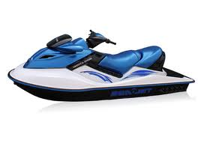
California’s Spark-Ignition Marine Watercraft Proposal
2014 IBEX Conference
October 1, 2014
Proposed Evaporative Emission Standards & Certification Process
Presenter: Scott Monday
California Air Resources Board

Slide 2
Presentation Outline
Objectives
What is the California Air Resources Board?
Purpose of CARB Regulation
Pathways to Compliance
Proposed Standards
Control Technology
CARB Evaporative Certification Process
Industry Cooperation
Next Steps
Contact Information

Slide 3
Presentation Outline
Objectives
What is the California Air Resources Board?
Purpose of CARB Regulation
Pathways to Compliance
Proposed Standards
Control Technology
CARB Evaporative Certification Process
Industry Cooperation
Next Steps
Contact Information

Slide 4
Objectives
Present the California Air Resources Board’s (CARB) proposed evaporative emission standards and regulations for spark-ignition marine watercraft (SIMW or boats)
Provide an overview of CARB’s proposed certification process

Slide 5
Presentation Outline
Objectives
What is the California Air Resources Board?
Purpose of CARB Regulation
Pathways to Compliance
Proposed Standards
Control Technology
CARB Evaporative Certification Process
Industry Cooperation
Next Steps
Contact Information

Slide 6
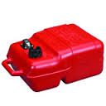
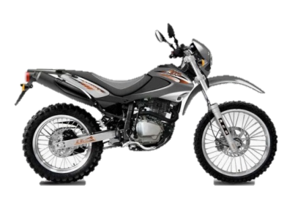
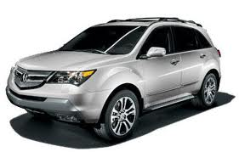
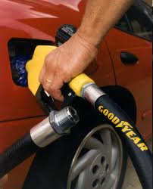

What is the California Air Resources Board?
CARB is a state government entity responsible for regulating air quality throughout California, including controlling emissions from mobile sources
Examples of mobile sources regulated by CARB include cars, trucks, lawn mowers, off-road recreational vehicles, and boats

Slide 7
Presentation Outline
Objectives
What is the California Air Resources Board?
Purpose of CARB Regulation
Pathways to Compliance
Proposed Standards
Control Technology
CARB Evaporative Certification Process
Industry Cooperation
Next Steps
Contact Information

Slide 8
Purpose of CARB Regulation
California has the worst air quality in the nation
CARB develops regulations to comply with the federal Clean Air Act requirements
CARB’s proposed evaporative regulations for boats will meet a legal commitment included in California’s State Implementation Plan
This regulation will help California obtain the emission reductions needed for ozone attainment

Slide 9



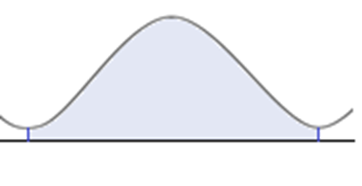
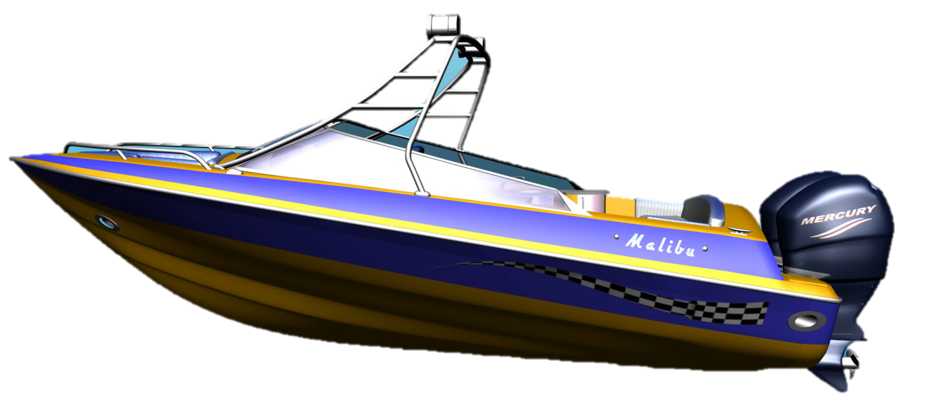


Focus of Regulation
Current proposal focuses on mitigating diurnal evaporative emissions
24 Hours
Previous regulations mitigated exhaust emissions

Slide 10
Presentation Outline
Objectives
What is the California Air Resources Board?
Purpose of CARB Regulation
Pathways to Compliance
Proposed Standards
Control Technology
CARB Evaporative Certification Process
Industry Cooperation
Next Steps
Contact Information

Slide 11
Applicability
CARB’s regulatory proposal applies to all
spark-ignition marine watercraft with permanently installed fuel tanks sold in California
  Only marine watercraft that use engines > 40HP must meet the more stringent standards
  Marine watercraft that use engines ≤ 40HP will continue to meet U.S. EPA standards

Slide 12
Pathways to Compliance
CARB’s draft regulation has two methods for demonstrating compliance:
Design-Based – Requires marine watercraft manufacturer to use specific CARB-certified components for:
      Fuel injection
      Low permeation fuel hoses
      Low permeation fuel tank
      Passively-purged carbon canister or pressure relief valve
      Performance Alternative – One standard for the complete boat or fuel system
    Based on a 24-hour diurnal test (TP-1501)

Slide 13
Presentation Outline
Objectives
What is the California Air Resources Board?
Purpose of CARB Regulation
Pathways to Compliance
Proposed Standards
Control Technology
CARB Evaporative Certification Process
Industry Cooperation
Next Steps
Contact Information

Slide 14
Design-Based Standards:
≤ 30 kW (40 HP)
All evaporative emission standards and test procedures will be harmonized with U.S. EPA
Model Year (MY) Effective Date | Fuel Hose Permeation (grams/m²/day ROG) | Fuel Tank Permeation (grams/m²/ day ROG ) | Diurnal Requirement (grams/gallon/ day HC) | Fuel Injection or Equivalent (grams/hour)
2018 and later | 15.0 | 1.5 | 0.4 | None
Test Procedure | 40 CFR §1060.515 | 40 CFR §1060.520¹ | 40 CFR §1060.525 | None
¹ As an alternative, fuel tanks can be certified to 2.5 grams/m²/day at 40°C

Slide 15
Design-Based Standards:
> 30 kW (40 HP) Trailerable
For MY2018 and later, certain evaporative emission requirements (including fuel caps, primer bulbs, and fitting requirements) will be harmonized with U.S. EPA
For MY2018 and later, CARB proposes to set more stringent standards for fuel hose and fuel tank permeation, diurnal emissions, and require fuel injection
For MY2020 and later, CARB proposes to lower the fuel hose permeation standard
  Executive Officer must first confirm commercial availability

Slide 16
Design-Based Standards:
> 30 kW (40 HP) Trailerable
Applicable to marine watercraft ≤ 26 ft. in length and ≤ 8.5 ft.in width
Trailerable Boats
Model Year Effective Date | Fuel Hose Permeation (grams ROG/m²/day) | Fuel Tank Permeation (grams ROG/m²/day) | Diurnal Tank Venting Loss Requirement (grams HC/gallon/day) |  | Meet Fuel Injection Definition or Equivalent Performance Standard (grams HC/hour)
 |  |  | Canister¹ | Non-Canister
2018 and 2019 | 10.0 | 0.70 | 0.25 | 65% reduction from uncontrolled HC emissions | 0.4
2020 and later | 5.0² | 0.70 | 0.25 | 65% reduction from uncontrolled HC emissions | 0.4
Test Procedure | TP-1504 or SAE J1737 | TP-1504³ | TP-1503 |  | TP-1502
¹ Canisters can be certified by design as an option. Canisters must have a minimum butane working capacity of 3.8 grams/gallon
² Must be performed at 40°C
³ As an alternative, fuel tanks can be certified to 1.4 grams/m²/day at 40°C

Slide 17
Design-Based Standards:
> 30 kW (40 HP) Non-Trailerable
For MY2018 and later, certain evaporative emission requirements (including fuel caps, primer bulbs, and fitting requirements) will be harmonized with U.S. EPA
For MY2018 and later, CARB proposes to set more stringent standards for fuel hose and fuel tank permeation, diurnal emissions, and require fuel injection
For MY2020 and later, CARB proposes to lower the fuel hose permeation standard
  Executive Officer must first confirm commercial availability

Slide 18
Design-Based Standards:
> 30 kW (40 HP) Non-Trailerable
Applicable to marine watercraft ˃ 26 ft. in length or ˃ 8.5 ft. in width
Trailerable Boats
Model Year Effective Date | Fuel Hose Permeation (grams ROG/m²/day) | Fuel Tank Permeation (grams ROG/m²/day) | Diurnal Tank Venting Loss Requirement (grams HC/gallon/day) |  | Meet Fuel Injection Definition or Equivalent Performance Standard (grams HC/hour)
 |  |  | Canister¹ | Non-Canister
2018 and 2019 | 10.0 | 0.70 | 0.16 | 65% reduction from uncontrolled HC emissions | 0.4
2020 and later | 5.0² | 0.70 | 0.16 | 65% reduction from uncontrolled HC emissions | 0.4
Test Procedure | TP-1504 or SAE J1737 | TP-1504³ | TP-1503⁴ |  | TP-1502
¹ Canisters can be certified by design as an option. Canisters must have a minimum butane working capacity of 1.5 grams/gallon
² Must be performed at 40°C
³ As an alternative, fuel tanks can be certified to 1.4 grams/m²/day at 40°C
⁴ U.S. EPA Gasoline

Slide 19
Presentation Outline
Objectives
What is the California Air Resources Board?
Purpose of CARB Regulation
Pathways to Compliance
Proposed Standards
Control Technology
CARB Evaporative Certification Process
Industry Cooperation
Next Steps
Contact Information

Slide 20
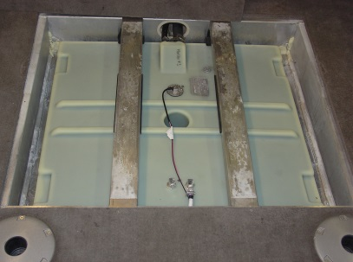
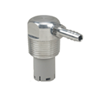
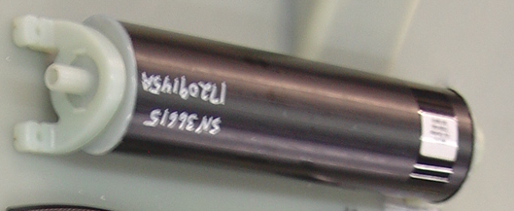
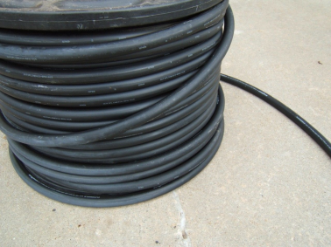
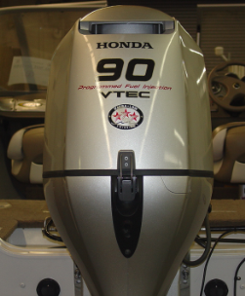
Anticipated CARB Control Technology
Similar to U.S. EPA controls except more stringent evaporative components
Lower Permeation Fuel Tank
Carbon Canister or PRV
Lower Permeation Fuel Hoses
Fuel Injection

Slide 21
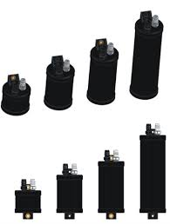
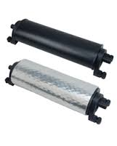
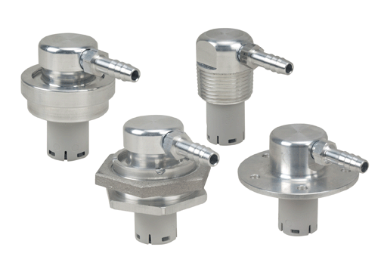
TP-1503 Venting Control Update
Carbon Canister
  Optional design requirement added
  Durability requirements added
Pressure Relief Valve
  Durability requirements modified
    Tolerances
    Temperature Stabilization

Slide 22
Presentation Outline
Objectives
What is the California Air Resources Board?
Purpose of CARB Regulation
Pathways to Compliance
Proposed Standards
Control Technology
CARB Evaporative Certification Process
Industry Cooperation
Next Steps
Contact Information

Slide 23
Overview of CARB Evaporative Certification Process

Slide 24
CARB Component Certification
Similar to U.S. EPA
Must include five data test points
Application must be deemed complete by CARB before it can be processed
CARB will issue a component Executive Order (EO) for each component
Engine manufacturer responsible for certification of fuel injection system

Slide 25
CARB Component Certification Process

Slide 26
CARB Boat Certification
What is boat certification?
  Boat builders demonstrate their product meets evaporative requirements
    Upon completion, a CARB EO is issued to allow sale of boat into California
  Boat builders certify an evaporative family
    One application per evaporative family
    An evaporative family can cover many models that utilize same type of components

Slide 27
CARB Boat Certification Process
How do I certify my boat?
  Plan model(s) design
  Group models into an evaporative family
  Submit application
  Build model
  Receive Executive Order
  Sell boat in California
Why is CARB boat evaporative certification required?
  Provides a formal legal document (EO) showing that the boat is CARB compliant

Slide 28
Boat Builder Planning
Boat builders should plan in advance the design of the evaporative system
  No significant modification for CARB evaporative configurations
  May have third party design evaporative system
  If models remain the same from previous year, boat builders can use previous information
Once a design has been established, the boat builder can apply for certification

Slide 29
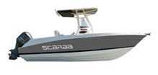
Evaporative System Builder
Definition
Any business, company, or manufacturer that installs or mounts a complete evaporative system on a spark-ignition marine watercraft (Title 13, CCR, §2853)
This could be a:
  Boat builder
  Fuel system builder/integrator
  Engine manufacturer
  Dealer

Slide 30
Evaporative System Builder Responsibilities
  Evaporative system builders (e.g., boat builders) demonstrate their evaporative system meets requirements
  Design fuel system using CARB certified components
  Placement and integration of evaporative components
  Proper installation of complete evaporative system
  Labeling and warranty
  Other requirements
  Obtain CARB EO

Slide 31
CARB Boat Evaporative Certification Process
Design-Based (2018 MY Example)

Slide 32
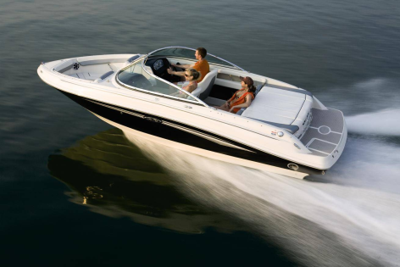
Boat Builder Application Process
Design-Based Application - Start of Model Year
    Boat builders submit one application for each evaporative family
    Boat builder may submit an application at any time after they know the model design
    On the application, reference the component EO numbers applicable to each evaporative component used in the evaporative family
    Submit the application to CARB
    If compliant, CARB issues an EO

Slide 33
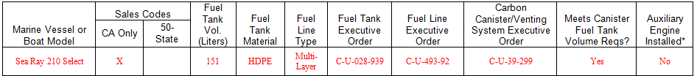
Boat Builder Application Process
(continued)
Design-Based Application - End of Model Year Report
  Submit before end of boat builder’s model year
  A summary of all boat models constructed for the applicable evaporative family
  Specify the CARB EO approved components used for each model

Slide 34
Evaporative Family
What is an evaporative family?
  Evaporative family means a class of evaporative components used on boats with similar fuel system characteristics
  Evaporative families have similar fuel hose types, fuel tank types, carbon canister sizes, etc.
Characteristics of evaporative families
  Vented control: carbon canister vs. pressure relief valve
  Fuel tank types: metal vs. plastic
  Fuel hose types: U.S. EPA vs. CARB
  Boat size: trailerable vs. nontrailerable

Slide 35
Evaporative Family
Example – Single Evaporative Family
Fuel System Design | Evaporative Family Type
Fuel Hose Type | A1-15
Fuel Tank Type | Plastic
Vent Type | Carbon Canisters 0.5L – 0-60 gallons 0.75L – 62-93 gallons 1.0L – 93-124 gallons
Trailerable or Nontrailerable | Trailerable
All models that have these characteristics are considered one evaporative family and need only one certification application

Slide 36
Evaporative Family
Example – Two Evaporative Families
Fuel System Design | Evaporative Family Type
Fuel Hose Type | A1-15
Fuel Tank Type | Plastic or Metal
Vent Type | Carbon Canisters 0.5L – 0-60 gallons 0.75L – 62-93 gallons
Trailerable/Nontrailerable | Trailerable
Models using plastic tanks will be in one evaporative family; models using metal tanks will be in a second family

Slide 37
Label & Warranty
Labels and warranty statements may be approved ahead of time
Approval remains valid for future model years provided no changes are made
CARB will furnish templates for evaporative emissions labels and warranty statements

Slide 38
Component Compliance Responsibility
CARB may conduct compliance testing on components
Component manufacturer and boat builder will be notified if a component fails compliance testing
Boat builder is not responsible for noncompliant component

Slide 39
Presentation Outline
Objectives
What is the California Air Resources Board?
Purpose of CARB Regulation
Pathways to Compliance
Proposed Standards
Control Technology
CARB Evaporative Certification Process
Industry Cooperation
Next Steps
Contact Information

Slide 40
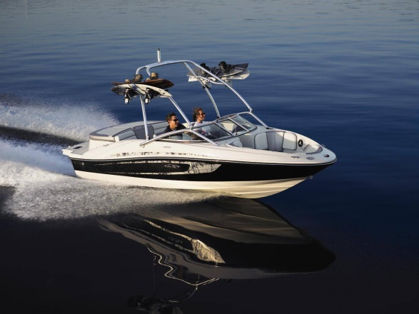
Cooperation with NMMA/ABYC to Date
NMMA has been actively engaged with CARB
  Working with CARB since 2006
  Actively participated in all CARB marine workshops
  Helped streamline CARB marine certification
  Provided information about current NMMA certification process

Slide 41
Cooperation with NMMA/ABYC to Date (cont.)
NMMA has been actively engaged with CARB
  Helped to understand the unique manufacturing process of the boat building industry
  Organized face-to-face meeting with ABYC, industry representatives, and boat builders
  Organized boat builder manufacturing tour

Slide 42
CARB/NMMA/ABYC Working Group Efforts
Conducted several meetings between CARB, NMMA, and ABYC in 2014
Worked on combined CARB/EPA/NMMA/USCG label
ABYC has initiated process to incorporate California evaporative requirements into H-24
Developed alternate CARB evaporative certification process to be streamlined with NMMA safety certification
  NMMA submits application to CARB for Boat Builder
  NMMA field inspectors will verify that evaporative components are CARB certified

Slide 43
Proposed Alternate CARB Evaporative Certification Process Streamlined with NMMA
- - - - Alternate path for NMMA members

Slide 44
Cooperation with NMMA/ABYC
Completed/Future Action Items
 | SUMMER 2014 | FALL 2014 | WINTER 2015 | SUMMER 2015
ARB | Approve combined NMMA/CARB/EPA/USCG label format. (completed) Work with NMMA to develop emissions warranty template based on proposed regulations. (completed) | Attend NMMA Certification inspection. (completed) Create CARB application based on proposed regulations. (completed) | Participate in technical session at NMMA Engineering Compliance seminar. (tentative) Provide NMMA with data fields for CARB certification. | Work with NMMA on needed reports for electronic certification database.
ABYC |  | Develop an annex in H-24, Gasoline Fuel Systems, standard based on CARB’s proposed requirements | Project Technical Committee (PTC) review and Technical Board approval
NMMA | Create a Type Accepted category for fuel system components needed for CARB certification. |  | Train NMMA inspectors on new CARB requirements of H-24 Distribute information and educate the boat builders through a series of webinars Add the additional H-24 Annex item to the certification inspection checklist. | Integrate the amended ABYC H-24 standard into the Boat & Yacht Certification program. Integrate CARB-provided data fields into NMMA Certification data software

Slide 45
Presentation Outline
Objectives
What is the California Air Resources Board?
Purpose of CARB Regulation
Pathways to Compliance
Proposed Standards
Control Technology
CARB Evaporative Certification Process
Industry Cooperation
Next Steps
Contact Information

Slide 46
Next Steps
Fall 2014:
ABYC Develops
H-24 Annex
February 2015:
CARB SIMW Board Hearing
December 2014:
Publish CARB
Regulatory Documents
Summer 2015:
ABYC Publish H-24 Annex

Slide 47
Next Steps (cont.)
Certification workshops and training for boat builders will follow Board adoption
Details about the proposal, test procedures and application can be found on CARB’s Recreational Marine Activities website:
  http://www.arb.ca.gov/msprog/offroad/recmarine/recmarine.htm

Slide 48
Presentation Outline
Objectives
What is the California Air Resources Board?
Purpose of CARB Regulation
Pathways to Compliance
Proposed Standards
Control Technology
CARB Evaporative Certification Process
Industry Cooperation
Next Steps
Contact Information

Slide 49
CARB Staff Contact Information
Scott Monday – Regulations, Test Procedures, and Component Certification
(916) 445-9319, smonday@arb.ca.gov
Kevin Curley – Boat Certification
(626) 350-6418, kcurley@arb.ca.gov

Slide 50
Questions?

